Slide 1
Linear Regression

Slide 2
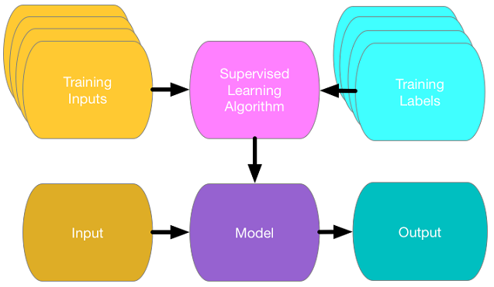

Slide 3

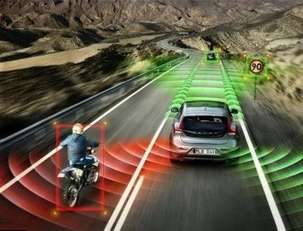
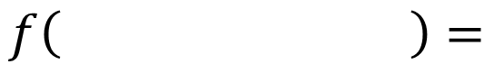
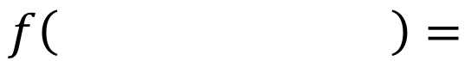
Linear Regression: Output a scalar
Stock Market Forecast
Self-driving Car
Recommendation
$$f\left( \right)=$$
明天某股票的股价
$$f\left( \right)=$$
方向盘角度
$$f\left( \right)=$$
购买可能性
使用者 A
商品 B

Slide 4
Linear Regression (Simple data)
x | y
1 | 1
2 | 2
3 | 3

Slide 5
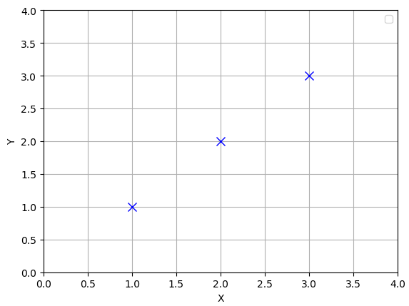
Linear Regression (presentation)
x | Y
1 | 1
2 | 2
3 | 3

Slide 6
(Linear) Hypothesis
X = 2.5
Y = ?

Slide 7
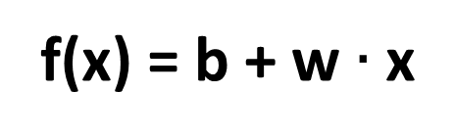
(Linear) Hypothesis
f(x) = b + w $∙$ x

Slide 8
Which hypothesis is better?

Slide 9
Which hypothesis is better?

Slide 10
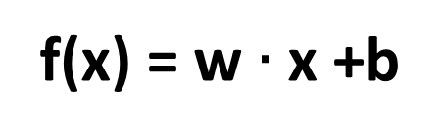
Cost function
How fit the line to our (training) data
f(x) = w $∙$ x +b
f(x) - y

Slide 11
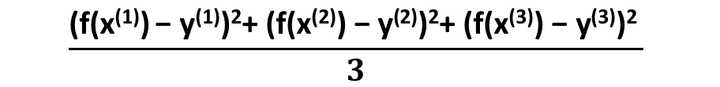
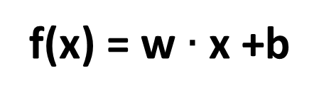
Cost function
How fit the line to our (training) data
$$\frac{\text{(}\text{f}\text{(}\text{x}\text{(1)}\text{)} \text{− }\text{y}\text{(1)}\text{)}\text{2}\text{+ (}\text{f}\text{(}\text{x}\text{(}\text{2}\text{)}\text{)} \text{− }\text{y}\text{(}\text{2}\text{)}\text{)}\text{2}\text{+ (}\text{f}\text{(}\text{x}\text{(}\text{3}\text{)}\text{)} \text{− }\text{y}\text{(}\text{3}\text{)}\text{)}\text{2} }{3}$$
f(x) = w $∙$ x +b

Slide 12
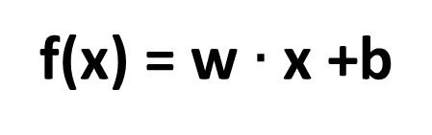
Cost function
f(x) = w $∙$ x +b

Slide 13
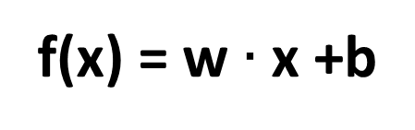
Simplified hypothesis in TF
f(x) = w $∙$ x +b
hypothesis = tf.matmul(X, W) + b
cost = tf.reduce_mean(tf.square(hypothesis - y_train))

Slide 14
Goal: Minimize cost
Minimize L(w,b)
w,b

Slide 15
What L(W) looks like?
x | Y
1 | 1
2 | 2
3 | 3
W=1, L(W)=?

Slide 16
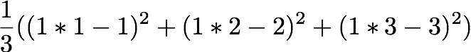
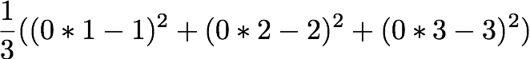
What L(W) looks like?
x | Y
1 | 1
2 | 2
3 | 3
W=1, L(W)=0
W=0, L(W)=4.67
W=2, L(W)=?

Slide 17
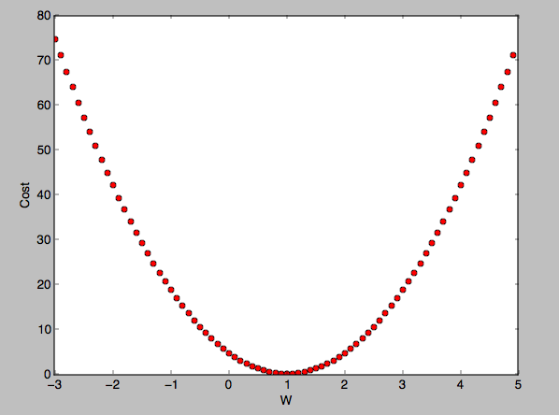
What L(W) looks like?
W=1, cost(W)=0
W=0, cost(W)=4.67
W=2, cost(W)=4.67
Notes:
L(w)关于w的最高项为2次，故对应的曲线为类似碗的形状

Slide 18
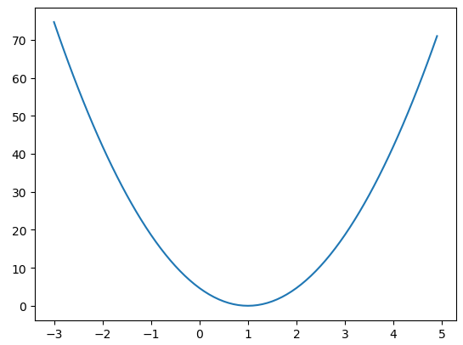
How to minimize cost L(w)?
minimizing_cost_show_graph.py

Slide 19
Formal definition
Repeat

Slide 20
Gradient descent algorithm in TF
cost = tf.reduce_mean(tf.square(hypothesis - y_train))
train = tf.train.GradientDescentOptimizer(learning_rate=0.01).minimize(cost)
# Assume ŋ=0.01

Slide 21


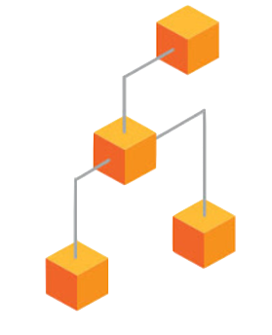



TensorFlow Mechanics
feed data and run graph (operation) sess.run (op, feed_dict={x: x_data})
Build graph using
TensorFlow operations
update variables
in the graph
(and return values)

Slide 22
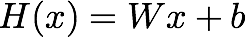
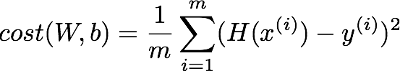
Build graph using TF operations
# X and Y data
x_train = [1, 2, 3]
y_train = [1, 2, 3]
W = tf.Variable(tf.random_normal([1]), name='weight')
b = tf.Variable(tf.random_normal([1]), name='bias')
# Our hypothesis XW+b
hypothesis = x_train * W + b
# cost/loss function
cost = tf.reduce_mean(tf.square(hypothesis - y_train))

Slide 23
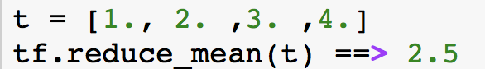
Build graph using TF operations
# cost/loss function
cost = tf.reduce_mean(tf.square(hypothesis - y_train))
GradientDescent
# Minimize
optimizer = tf.train.GradientDescentOptimizer(learning_rate=0.01)
train = optimizer.minimize(cost)
https://www.tensorflow.org/api_docs/python/tf/reduce_mean

Slide 24
Run/update graph and get results
# Launch the graph in a session.
sess = tf.Session()
# Initializes global variables in the graph.
sess.run(tf.global_variables_initializer())
# Fit the line
for step in range(2001):
sess.run(train)
if step % 20 == 0:
print(step, sess.run(cost), sess.run(W), sess.run(b))

Slide 25
import tensorflow as tf
# X and Y data
x_train = [1, 2, 3]
y_train = [1, 2, 3]
W = tf.Variable(tf.random_normal([1]), name='weight')
b = tf.Variable(tf.random_normal([1]), name='bias')
# Our hypothesis XW+b
hypothesis = x_train * W + b
# cost/loss function
cost = tf.reduce_mean(tf.square(hypothesis - y_train))
# Minimize
optimizer = tf.train.GradientDescentOptimizer(learning_rate=0.01)
train = optimizer.minimize(cost)
# Launch the graph in a session.
sess = tf.Session()
# Initializes global variables in the graph.
sess.run(tf.global_variables_initializer())
# Fit the line
for step in range(2001):
sess.run(train)
if step % 20 == 0:
print(step, sess.run(cost), sess.run(W), sess.run(b))
Full code (less than 20 lines)
'''
0 2.82329 [ 2.12867713] [-0.85235667]
20 0.190351 [ 1.53392804] [-1.05059612]
40 0.151357 [ 1.45725465] [-1.02391243]
...
1920 1.77484e-05 [ 1.00489295] [-0.01112291]
1940 1.61197e-05 [ 1.00466311] [-0.01060018]
1960 1.46397e-05 [ 1.004444] [-0.01010205]
1980 1.32962e-05 [ 1.00423515] [-0.00962736]
2000 1.20761e-05 [ 1.00403607] [-0.00917497]
'''
linear_regression.py

Slide 26
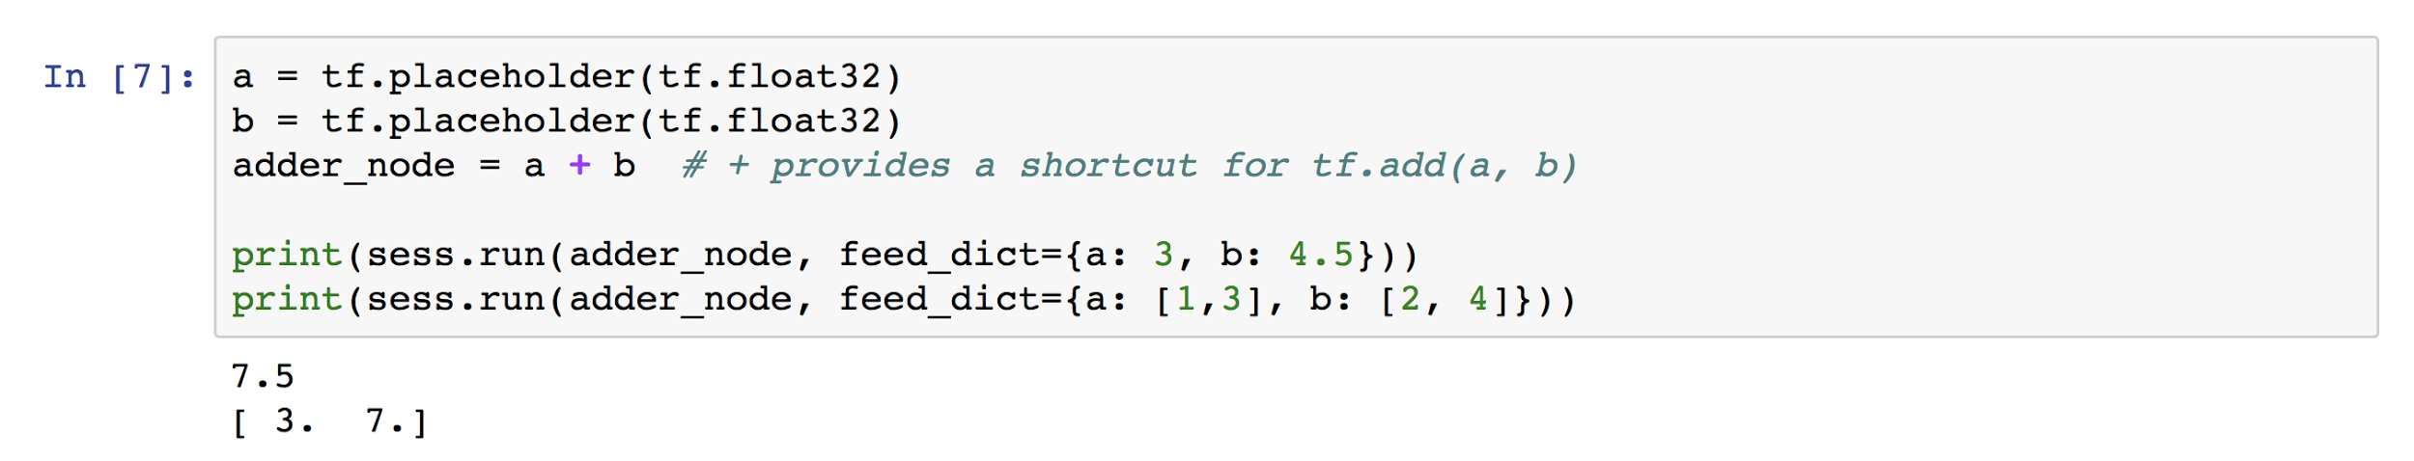
Placeholders

Slide 27
Placeholders
# X and Y data
x_train = [1, 2, 3]
y_train = [1, 2, 3]
# Now we can use X and Y in place of x_data and y_data
# # placeholders for a tensor that will be always fed using feed_dict
# See http://stackoverflow.com/questions/36693740/
X = tf.placeholder(tf.float32)
Y = tf.placeholder(tf.float32)
...
# Fit the line
for step in range(2001):
cost_val, W_val, b_val, _ = \
sess.run([cost, W, b, train],
feed_dict={X: [1, 2, 3], Y: [1, 2, 3]})
if step % 20 == 0:
print(step, cost_val, W_val, b_val)

Slide 28
import tensorflow as tf
W = tf.Variable(tf.random_normal([1]), name='weight')
b = tf.Variable(tf.random_normal([1]), name='bias')
X = tf.placeholder(tf.float32, shape=[None])
Y = tf.placeholder(tf.float32, shape=[None])
# Our hypothesis XW+b
hypothesis = X * W + b
# cost/loss function
cost = tf.reduce_mean(tf.square(hypothesis - Y))
# Minimize
optimizer = tf.train.GradientDescentOptimizer(learning_rate=0.01)
train = optimizer.minimize(cost)
# Launch the graph in a session.
sess = tf.Session()
# Initializes global variables in the graph.
sess.run(tf.global_variables_initializer())
# Fit the line
for step in range(2001):
cost_val, W_val, b_val, _ = sess.run([cost, W, b, train],
feed_dict={X: [1, 2, 3], Y: [1, 2, 3]})
if step % 20 == 0:
print(step, cost_val, W_val, b_val)
Full code with placeholders
...
1980 1.32962e-05 [ 1.00423515] [-0.00962736]
2000 1.20761e-05 [ 1.00403607] [-0.00917497]
# Testing our model
print(sess.run(hypothesis, feed_dict={X: [5]}))
print(sess.run(hypothesis, feed_dict={X: [2.5]}))
print(sess.run(hypothesis,
feed_dict={X: [1.5, 3.5]}))
[ 5.0110054]
[ 2.50091505]
[ 1.49687922 3.50495124]
linear_regression_feed.py

Slide 29
import tensorflow as tf
W = tf.Variable(tf.random_normal([1]), name='weight')
b = tf.Variable(tf.random_normal([1]), name='bias')
X = tf.placeholder(tf.float32, shape=[None])
Y = tf.placeholder(tf.float32, shape=[None])
# Our hypothesis XW+b
hypothesis = X * W + b
# cost/loss function
cost = tf.reduce_mean(tf.square(hypothesis - Y))
# Minimize
optimizer = tf.train.GradientDescentOptimizer(learning_rate=0.01)
train = optimizer.minimize(cost)
# Launch the graph in a session.
sess = tf.Session()
# Initializes global variables in the graph.
sess.run(tf.global_variables_initializer())
# Fit the line with new training data
for step in range(2001):
cost_val, W_val, b_val, _ = sess.run([cost, W, b, train],
feed_dict={X: [1, 2, 3, 4, 5],
Y: [2.1, 3.1, 4.1, 5.1, 6.1]})
if step % 20 == 0:
print(step, cost_val, W_val, b_val)
Full code with placeholders
…
1960 3.32396e-07 [ 1.00037301] [ 1.09865296]
1980 2.90429e-07 [ 1.00034881] [ 1.09874094]
2000 2.5373e-07 [ 1.00032604] [ 1.09882331]
# Testing our model
print(sess.run(hypothesis, feed_dict={X: [5]}))
print(sess.run(hypothesis, feed_dict={X: [2.5]}))
print(sess.run(hypothesis,
feed_dict={X: [1.5, 3.5]}))
[ 6.10045338]
[ 3.59963846]
[ 2.59931231 4.59996414]

Slide 30
机器学习的定义
Mitchell(1997)：对于某类任务T和性能度量P，一个计算机程序被认为可以从经验E中学习是指，通过经验E改进后，它在任务T上由性能度量P衡量的性能有所提升。
任务T：
性能度量P：
经验E：

Slide 31
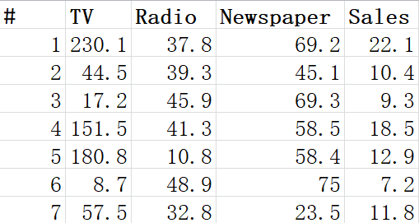
Linear Regression- Another Example
Prediction of Sales, according to consumption on TV, Radio, Newspaper

Slide 32
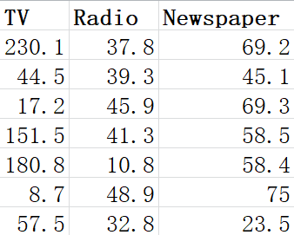
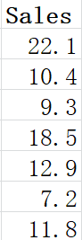
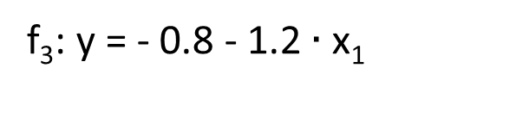
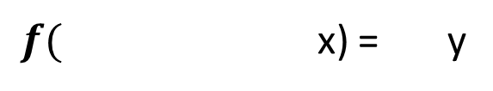
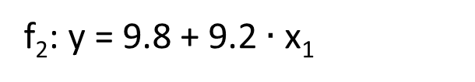
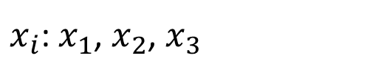
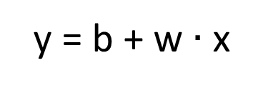
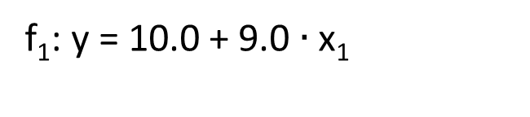
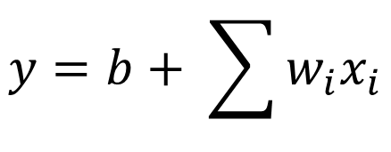
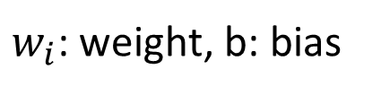
Step 1: Model
w and b are parameters (can be any value)
y = b + w $∙$ x
f₁: y = 10.0 + 9.0 $∙$ x₁
A set of function
Model
f₂: y = 9.8 + 9.2 $∙$ x₁
f₃: y = - 0.8 - 1.2 $∙$ x₁
…… infinite
$f( \text{x}\text{)}$ = y
$x_{i}$: $x_{1}$, $x_{2}$, $x_{3}$
$$y=b+ \sum{w_{i}x_{i}}$$
feature
Linear model:
$w_{i}$: weight, b: bias

Slide 33
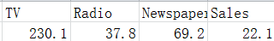
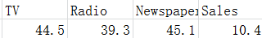
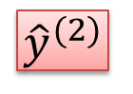
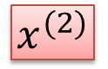
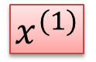
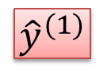
Step 2: Goodness of Function
y = b + w $∙$ x
A set of function
Model
function
input:
function
Output (scalar):
$$x^{(1)}$$
$${\hat{y}}^{(1)}$$
$$x^{(2)}$$
$${\hat{y}}^{(2)}$$
Training
Data

Slide 34
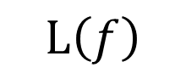
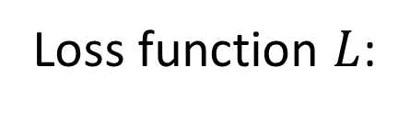
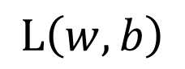
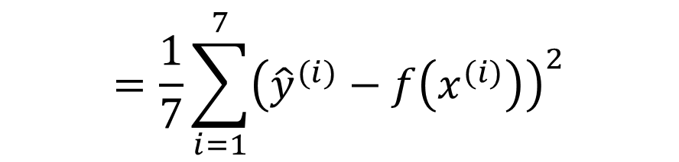
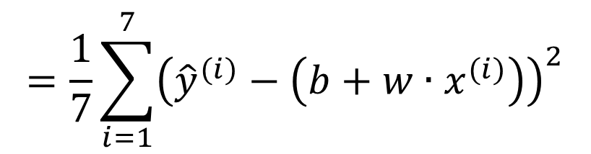
Step 2: Goodness of Function
y = b + w $∙$ x
A set of function
Loss function $L$:
Model
Input: a function, output: how bad it is
Estimation error
$$=\frac{1}{7}\sum_{i=1}^{7}{{\left({\hat{y}}^{(i)}−f\left(x_{}^{(i)}\right)\right)}^{2}}$$
Goodness of function f
$$L\left(f\right)$$
Sum over examples
Estimated y based on input function
Training
Data
$$L\left(w,b\right)$$
$$=\frac{1}{7}\sum_{i=1}^{7}{{\left({\hat{y}}^{(i)}−\left(b+w∙x_{}^{(i)}\right)\right)}^{2}}$$

Slide 35
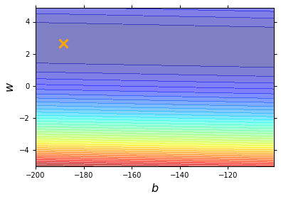
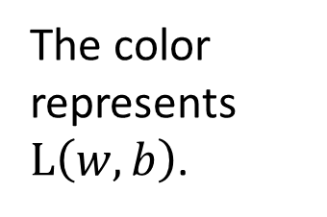
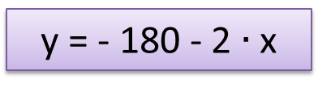
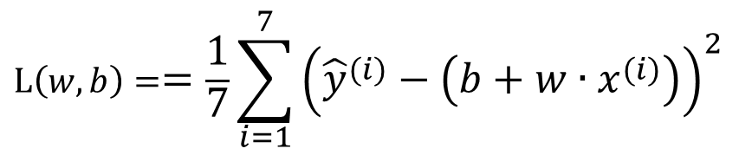
Step 2: Goodness of Function
$$L\left(w,b\right)==\frac{1}{7}\sum_{i=1}^{7}{{\left({\hat{y}}^{(i)}−\left(b+w∙x_{}^{(i)}\right)\right)}^{2}}$$
Loss Function
Each point in the figure is a function
smallest
y = - 180 - 2 $∙$ x
The color represents $L\left(w,b\right)$.
Very large

Slide 36
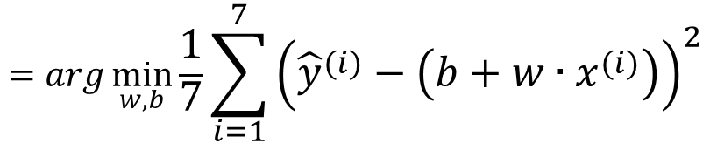
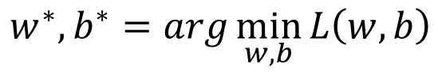
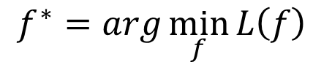
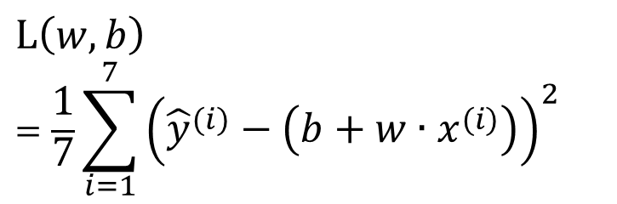
Step 3: Best Function
$$L\left(w,b\right)$$
$$=\frac{1}{7}\sum_{i=1}^{7}{{\left({\hat{y}}^{(i)}−\left(b+w∙x_{}^{(i)}\right)\right)}^{2}}$$
A set of function
Model
Goodness of function f
Pick the “Best” Function
$$f^{∗}=\arg{\min_{f}{L\left(f\right)}}$$
Gradient Descent
Training
Data
$$w^{∗},b^{∗}=arg\min_{w,b}{L\left(w,b\right)}$$
$$=arg\min_{w,b}{\frac{1}{7}\sum_{i=1}^{7}{{\left({\hat{y}}^{(i)}−\left(b+w∙x_{}^{(i)}\right)\right)}^{2}}}$$

Slide 37




Step 3: Gradient Descent
http://chico386.pixnet.net/album/photo/171572850
$$w^{∗}=arg\min_{w}{L\left(w\right)}$$
Consider loss function 𝐿(𝑤) with one parameter w:
(Randomly) Pick an initial value w⁰
Compute $\frac{dL}{dw}|_{w=w^{(0)}}$
Loss
$$L\left(w\right)$$
Negative
Increase w
Positive
Decrease w
w⁰

Slide 38


Step 3: Gradient Descent
http://chico386.pixnet.net/album/photo/171572850
$$w^{∗}=arg\min_{w}{L\left(w\right)}$$
Consider loss function 𝐿(𝑤) with one parameter w:
(Randomly) Pick an initial value w⁽⁰⁾
Compute $\frac{dL}{dw}|_{w=w^{(0)}}$
Loss
$$L\left(w\right)$$
$$w^{(1)}←w^{(0)}−η\frac{dL}{dw}|_{w=w^{(0)}}$$
η is called “learning rate”
W⁽⁰⁾
$$−η\frac{dL}{dw}|_{w=w^{(0)}}$$

Slide 39



Step 3: Gradient Descent
$$w^{∗}=arg\min_{w}{L\left(w\right)}$$
Consider loss function 𝐿(𝑤) with one parameter w:
(Randomly) Pick an initial value w⁰
Compute $\frac{dL}{dw}|_{w=w^{(0)}}$
Loss
$$L\left(w\right)$$
$$w^{(1)}←w^{(0)}−η\frac{dL}{dw}|_{w=w^{(0)}}$$
Compute $\frac{dL}{dw}|_{w=w^{(1)}}$
$$w^{(2)}←w^{(1)}−η\frac{dL}{dw}|_{w=w^{(1)}}$$
…… Many iteration
Local minima
global minima
W⁽⁰⁾
W⁽¹⁾
W⁽²⁾
W^{(T)}

Slide 40








Step 3: Gradient Descent
$$\left[\begin{aligned}\frac{∂L}{∂w} \\ \frac{∂L}{∂b}\end{aligned}\right]$$
$$∇L=$$
gradient
How about two parameters?
$$w^{∗},b^{∗}=arg\min_{w,b}{L\left(w,b\right)}$$
(Randomly) Pick an initial value w⁽⁰⁾, b⁽⁰⁾
Compute $\frac{∂L}{∂w}|_{w=w^{(0)},b=b^{(0)}}$, $\frac{∂L}{∂b}|_{w=w^{(0)},b=b^{(0)}}$
$$w^{(1)}←w^{(0)}−η\frac{∂L}{∂w}|_{w=w^{(0)},b=b^{(0)}}$$
$$b^{(1)}←b^{(0)}−η\frac{∂L}{∂b}|_{w=w^{(0)},b=b^{(0)}}$$
Compute $\frac{∂L}{∂w}|_{w=w^{(1)},b=b^{(1)}}$, $\frac{∂L}{∂b}|_{w=w^{(1)},b=b^{(1)}}$
$$w^{(2)}←w^{(1)}−η\frac{∂L}{∂w}|_{w=w^{(1)},b=b^{(1)}}$$
$$b^{(2)}←b^{(1)}−η\frac{∂L}{∂b}|_{w=w^{(1)},b=b^{(1)}}$$

Slide 41





Step 3: Gradient Descent
Color: Value of Loss L(w,b)
$$w$$
$(−η{∂L}/{∂b}$, $−η{∂L}/{∂w})$
Compute ${∂L}/{∂b}$, ${∂L}/{∂w}$
$$b$$
Notes:
Don’t worry. In linear regression, the loss function L is convex.
No local minima

Slide 42


Step 3: Gradient Descent
When solving:
Each time we update the parameters, we obtain $θ$ that makes $L\left(θ\right)$ smaller.
$$θ^{∗}=arg\max_{θ}{L\left(θ\right)}$$
by gradient descent
$$L\left(θ^{(0)}\right)>L\left(θ^{(1)}\right)>L\left(θ^{(2)}\right)>…$$
Is this statement correct?

Slide 43







Step 3: Gradient Descent
Loss
Very slow at the plateau
$$L$$
Stuck at saddle point
$$w_{1}$$
$$w_{2}$$
Stuck at local minima
$$∂L∕∂w$$
$$≈0$$
$$∂L∕∂w$$
$$=0$$
$$∂L∕∂w$$
$$=0$$
The value of the parameter w

Slide 44





Step 3: Gradient Descent
Formulation of ${∂L}/{∂w}$ and ${∂L}/{∂b}$
$$L\left(w,b\right)=\frac{1}{7}\sum_{i=1}^{7}{{\left({\hat{y}}^{(i)}−\left(b+w∙x_{cp}^{(i)}\right)\right)}^{2}}$$
$$\frac{1}{7}\sum_{i=1}^{7}{2\left({\hat{y}}^{(i)}−\left(b+w∙x_{cp}^{(i)}\right)\right)\left(−x_{cp}^{(i)}\right)}$$
$$\frac{∂L}{∂w}=?$$
$$\frac{∂L}{∂b}=?$$

Slide 45



Step 3: Gradient Descent
Formulation of ${∂L}/{∂w}$ and ${∂L}/{∂b}$
$$L\left(w,b\right)=\frac{1}{7}\sum_{i=1}^{7}{{\left({\hat{y}}^{(i)}−\left(b+w∙x_{cp}^{(i)}\right)\right)}^{2}}$$
$$\frac{1}{7}\sum_{i=1}^{7}{2\left({\hat{y}}^{(i)}−\left(b+w∙x_{cp}^{(i)}\right)\right)\left(−x_{cp}^{(i)}\right)}$$
$$\frac{∂L}{∂w}=?$$
$$\frac{∂L}{∂b}=?$$
$$\frac{1}{7}\sum_{i=1}^{7}{2\left({\hat{y}}^{(i)}−\left(b+w∙x_{cp}^{(i)}\right)\right)\left(−1\right)}$$

Slide 46


f(x_{TV}, x_{Radio}, x_{Newspaer})=y
Training Data
Testing Data
multi_variable_linear_regression.py
multi_variable_matmul_linear_regression.py
file_input_linear_regression.py
tf_reader_linear_regression.py

Slide 47
Simplified Model: f(x_{TV})=y
Training Data
Testing Data

Slide 48





Model 1: y = b + w $∙$ x_{TV}
Training Data
b=7.83
w = 0.054
Average Error on Training Data
$$e^{(2)}$$
$$e^{(1)}$$
$$=\frac{1}{7}\sum_{i=1}^{7}{e^{(i)}}$$
= 4.843
Notes:
step: 3433 Training...Cost= 4.84317
step: 3433 Testing...Cost= 14.3198
real w1,b: [array([ 0.05397139], dtype=float32), array([ 7.83362913], dtype=float32)]
step: 17884 Training...Cost= 4.8322
step: 17884 Testing...Cost= 14.2049
real w1,w2,b: [array([ 0.04811323], dtype=float32), array([ 2.55461127e-05], dtype=float32), array([ 7.98640108], dtype=float32)]
step: 32508 Training...Cost= 3.72574
step: 32508 Testing...Cost= 25.501
real w1,w2,w3,b: [array([ 0.16374671], dtype=float32), array([-0.0011891], dtype=float32), array([ 3.33052890e-06], dtype=float32), array([ 6.03265285], dtype=float32)]
step: 111750 Training...Cost= 2.22085
step: 111750 Testing...Cost= 170.537
real w1,w2,w3,w4,b: [array([ 0.01919615], dtype=float32), array([ 0.00241323], dtype=float32), array([ -2.31604572e-05], dtype=float32), array([ 5.86446696e-08], dtype=float32), array([ 7.22432327], dtype=float32)]
step: 100140 Training...Cost= 0.639202
step: 100140 Testing...Cost= 1384.44
real w1,w2,w3,w4,w5,b: [array([-0.11393704], dtype=float32), array([ 0.0043423], dtype=float32), array([ -1.70163639e-05], dtype=float32), array([ -9.13407376e-08], dtype=float32), array([ 4.23158175e-10], dtype=float32), array([ 64.25491333], dtype=float32)]

Slide 49



How’s the results? - Generalization
What we really care about is the error on new data (testing data)
Another 7 data as testing data
y = b + w $∙$ x_{TV}
b = 7.83
How can we do better?
w = 0.054
Average Error on Testing Data
$$=\frac{1}{7}\sum_{i=1}^{7}{e^{(i)}}$$
= 14.32
> Average Error on Training Data (4.843)
Notes:
step: 3433 Training...Cost= 4.84317
step: 3433 Testing...Cost= 14.3198
real w1,b: [array([ 0.05397139], dtype=float32), array([ 7.83362913], dtype=float32)]
step: 17884 Training...Cost= 4.8322
step: 17884 Testing...Cost= 14.2049
real w1,w2,b: [array([ 0.04811323], dtype=float32), array([ 2.55461127e-05], dtype=float32), array([ 7.98640108], dtype=float32)]
step: 32508 Training...Cost= 3.72574
step: 32508 Testing...Cost= 25.501
real w1,w2,w3,b: [array([ 0.16374671], dtype=float32), array([-0.0011891], dtype=float32), array([ 3.33052890e-06], dtype=float32), array([ 6.03265285], dtype=float32)]
step: 111750 Training...Cost= 2.22085
step: 111750 Testing...Cost= 170.537
real w1,w2,w3,w4,b: [array([ 0.01919615], dtype=float32), array([ 0.00241323], dtype=float32), array([ -2.31604572e-05], dtype=float32), array([ 5.86446696e-08], dtype=float32), array([ 7.22432327], dtype=float32)]
step: 100140 Training...Cost= 0.639202
step: 100140 Testing...Cost= 1384.44
real w1,w2,w3,w4,w5,b: [array([-0.11393704], dtype=float32), array([ 0.0043423], dtype=float32), array([ -1.70163639e-05], dtype=float32), array([ -9.13407376e-08], dtype=float32), array([ 4.23158175e-10], dtype=float32), array([ 64.25491333], dtype=float32)]

Slide 50



Selecting another Model
Model 2
y = b + w₁ $∙$ x_{TV} + w₂ $∙$ (x_{TV})²
Best Function
b = 7.99
w₁ = 0.048, w₂ = 0.26 x 10⁻⁶
Average Error = 4.832
Testing:
Average Error = 14.205
Slightly better.
How about more complex model?
Notes:
step: 17884 Training...Cost= 4.8322
step: 17884 Testing...Cost= 14.2049
real b,w1,w2: [ 7.98640108] [ 0.04811323] [ 2.55461127e-05]

Slide 51



Selecting another Model
Model 3
y = b + w₁ $∙$x_{TV}+ w₂ $∙$ (x_{TV})²
+ w₃ $∙$ (x_{TV})³
Best Function
b = 6.03, w₁ = 0.164
w₂ = 1.19 x 10⁻³
w₃ =3.33x 10⁻⁶
Average Error = 3.726
Testing:
Average Error = 25.501
The results become worse ...
Notes:
step: 32508 Training...Cost= 3.72574
step: 32508 Testing...Cost= 25.501
real b,w1,w2,w3: [ 6.03265285] [ 0.16374671] [-0.0011891] [ 3.33052890e-06]

Slide 52



Selecting another Model
Model 4
y = b + w₁ $∙$ x_{TV} + w₂ $∙$ (x_{TV})²+ w₃ $∙$ (x_{TV})³ + w₄ $∙$ (x_{TV})⁴
Best Function
Average Error = 2.221
Testing:
Average Error = 170.537
The results become worse and worse ...
Notes:
step: 111750 Training...Cost= 2.22085
step: 111750 Testing...Cost= 170.537
real b,w1,w2,w3,w4: [ 7.22432327] [ 0.01919615] [ 0.00241323] [ -2.31604572e-05] [ 5.86446696e-08]

Slide 53



Selecting another Model
Model 5
y = b + w₁ $∙$ x_{TV} + w₂ $∙$ (x_{TV})²+ w₃ $∙$ (x_{TV})³ + w₄ $∙$ (x_{TV})⁴+ w₅ $∙$ (x_{TV})⁵
Best Function
Average Error = 0.639
Testing:
Average Error = 1384.44
The results are so bad.
Notes:
step: 100140 Training...Cost= 0.639202
step: 100140 Testing...Cost= 1384.44
real b,w1,w2,w3,w4,w5: [-0.11393704] [ 0.0043423] [ -1.70163639e-05] [ -9.13407376e-08] [ 4.23158175e-10] [ 64.25491333]

Slide 54






Model Selection
Training Data
1.
y = b + w $∙$ x_{TV}
2.
y = b + w₁ $∙$ x_{TV} + w₂ $∙$(x_{TV})²
y = b + w₁ $∙$x_{TV}+ w₂ $∙$ (x_{TV})²
+ w₃ $∙$ (x_{TV})³
3.
y = b + w₁ $∙$ x_{TV} + w₂ $∙$(x_{TV})² + w₃ $∙$ (x_{TV})³ + w₄ $∙$ (x_{TV})⁴
4.
y = b + w₁ $∙$ x_{TV} + w₂ $∙$ (x_{TV})² + w₃ $∙$ (x_{TV})³ + w₄ $∙$ (x_{TV})⁴+ w₅ $∙$ (x_{TV})⁵
A more complex model yields lower error on training data.
5.
If we can truly find the best function

Slide 55

Model Selection
Overfitting
 | Training | Testing
1 | 4.84 | 14.32
2 | 4.83 | 14.2
3 | 3.73 | 25.5
4 | 2.22 | 170.54
5 | 0.64 | 1384.44
A more complex model does not always lead to better performance on testing data.
This is Overfitting.
Select suitable model
Notes:
step: 3433 Training...Cost= 4.84317
step: 3433 Testing...Cost= 14.3198
real w1,b: [array([ 0.05397139], dtype=float32), array([ 7.83362913], dtype=float32)]
step: 17884 Training...Cost= 4.8322
step: 17884 Testing...Cost= 14.2049
real w1,w2,b: [array([ 0.04811323], dtype=float32), array([ 2.55461127e-05], dtype=float32), array([ 7.98640108], dtype=float32)]
step: 32508 Training...Cost= 3.72574
step: 32508 Testing...Cost= 25.501
real w1,w2,w3,b: [array([ 0.16374671], dtype=float32), array([-0.0011891], dtype=float32), array([ 3.33052890e-06], dtype=float32), array([ 6.03265285], dtype=float32)]
step: 111750 Training...Cost= 2.22085
step: 111750 Testing...Cost= 170.537
real w1,w2,w3,w4,b: [array([ 0.01919615], dtype=float32), array([ 0.00241323], dtype=float32), array([ -2.31604572e-05], dtype=float32), array([ 5.86446696e-08], dtype=float32), array([ 7.22432327], dtype=float32)]
step: 100140 Training...Cost= 0.639202
step: 100140 Testing...Cost= 1384.44
real w1,w2,w3,w4,w5,b: [array([-0.11393704], dtype=float32), array([ 0.0043423], dtype=float32), array([ -1.70163639e-05], dtype=float32), array([ -9.13407376e-08], dtype=float32), array([ 4.23158175e-10], dtype=float32), array([ 64.25491333], dtype=float32)]
------------------------------------------
x = np.linspace(1, 5, 5) Train_Err = [4.84317,4.8322,3.72574,2.22085,0.639202] Test_Err = [14.3198,14.2049,25.501,170.537,1384.44] plt.figure(1) plt.plot(x, np.log(Train_Err),'bo-', label="Training", color="blue",linewidth=2) plt.plot(x, np.log(Test_Err), 'r*-', label="Testing", color="Orange", linewidth=2) plt.xlabel("Model") plt.ylabel("Log(MSE_Error)") plt.title(" ") plt.xlim(1, 5) plt.ylim(-2, 10) plt.grid(True) plt.legend() plt.show()

Slide 56
Back to step 1: Choose more features and Redesign the Model
x
Training Error
= 1.9
$$y=\text{b}\text{ + }\text{w}\text{1} ∙\text{x}\text{TV} \text{+ }\text{w}\text{2} ∙\text{(}\text{xTV}\text{)2}$$
$$\text{+ }\text{w}\text{3} ∙ \text{xRa}\text{dio}\text{+ }\text{w}\text{4} ∙\text{(}\text{x}\text{Rad}\text{io}\text{)}\text{2}$$
Testing Error
= 14.6
$$\text{+ }\text{w}\text{5} ∙\text{x}\text{Newspaper}\text{+ }\text{w}\text{6} ∙\text{(}\text{x}\text{Newspaper}\text{)}\text{2}$$
Overfitting!
y
Notes:
Training...Cost= 1.91326
Testing...Cost= 14.5859
b,w1,w2,w3,w4,w5,w6: [ 1.6373167] [ 0.07775562] [-0.0001099] [ 0.16305755] [ 0.00051448] [ 2.37484010e-09] [ -1.10911461e-10]

Slide 57

Collect more data for training
Training Data

Slide 58








Back to step 2: Regularization
$$y=b+\sum_{i=1}^{n}{{w_{i}x_{i}}^{(j)}}$$
The functions with smaller $w_{i}$ are better
$$L=\sum_{j=1}^{m}{{\left({\hat{y}}^{(j)}−\left(b+\sum_{i=0}^{n}{{w_{i}x_{i}}^{(j)}}\right)\right)}^{2}}$$
$$+λ\sum_{i=1}^{n}{{{{\left(w_{i}\right)}^{2}}_{}}^{}}$$
Smaller $w_{i}$ means …
smoother
$$y=b+\sum_{i=1}^{n}{{w_{i}x_{i}}^{(j)}}$$
$$y+\sum_{i=1}^{n}{{w_{i}Δx_{i}}^{}}$$
$$=b+\sum_{i=1}^{n}{{w_{i}{{(x}_{i}\text{+}\text{Δ}\text{x}\text{i} )}_{}}^{}}$$
We believe smoother function is more likely to be correct
Do you have to apply regularization on bias?

Slide 59



Regularization
$$λ$$ | Training | Testing
0 | 1.9 | 14.6
1 | 2.3 | 68.7
10 | 3.5 | 25.7
100 | 4.1 | 11.1
1000 | 5.6 | 12.8
10000 | 6.3 | 18.7
100000 | 8.5 | 26.8
smoother
How smooth?
Select $λ$ obtaining the best model
Training error: larger $λ$ & considering the training error less
We prefer smooth function, but don’t be too smooth.

Slide 60
Next…
We finally get average error = 11.1 on the testing data
How about new data? Larger error? Lower error?
Next lecture: Where does the error come from?
More theory about overfitting and regularization
The concept of validation
Gradient descent & regularization
More theory and tips in the following lectures

Slide 61
Where does the error come from?

Slide 62

Review
Average Error on Testing Data
error due to "bias" and error due to "variance"
A more complex model does not always lead to better performance on testing data.
Notes:
We have to know where is the error come from?

Slide 63








Estimator
$$\hat{y}=\hat{f}\left( \right)$$
Bias + Variance
$$f^{∗}$$
$\hat{f} is unkown$
From training data, we find $f^{∗}$
$$\hat{f}$$
$f^{∗}$ is an estimator of $\hat{f}$

Slide 64










Bias and Variance in estimator of mean and variance
unbiased
Assume the mean of variable x is $μ$
Assume the variance of variable x is $σ^{2}$
Estimator of mean $μ$
Sample N points: $\left\{x^{1},x^{2},…,x^{N}\right\}$
$$m_{2}$$
$$m_{5}$$
$$m_{1}$$
$$μ$$
$$m=\frac{1}{N}\sum_{n}{x^{n}}$$
$$≠μ$$
$$m_{4}$$
$$m_{3}$$
$$E\left[m\right]=E\left[\frac{1}{N}\sum_{n}{x^{n}}\right]$$
$$=\frac{1}{N}\sum_{n}{E\left[x^{n}\right]}$$
$$=μ$$
$$m_{6}$$

Slide 65




Bias and Variance in estimator of mean and variance
Assume the mean of variable x is $μ$
Assume the variance of variable x is $σ^{2}$
Estimator of mean $μ$
Sample N points: $\left\{x^{1},x^{2},…,x^{N}\right\}$
unbiased
Smaller N
Larger N
$$m=\frac{1}{N}\sum_{n}{x^{n}}$$
$$≠μ$$
$$μ$$
$$μ$$
Variance depends on the number of samples
$$Var\left[m\right]=\frac{σ^{2}}{N}$$

Slide 66













Bias and Variance in estimator of mean and variance
biased
Increase N
Estimate the mean of a variable x
assume the mean of x is $μ$
assume the variance of x is $σ^{2}$
Estimator of variance $σ^{2}$
Sample N points: $\left\{x^{1},x^{2},…,x^{N}\right\}$
$$s_{3}$$
$$σ^{2}$$
$$σ^{2}$$
$$s_{1}$$
$$m=\frac{1}{N}\sum_{n}{x^{n}}$$
$$s=\frac{1}{N}\sum_{n}{{\left(x^{n}−m\right)}^{2}}$$
$$s_{4}$$
$$s_{5}$$
Biased estimator
$$s_{2}$$
$$s_{6}$$
$$E\left[s\right]=\frac{N−1}{N}σ^{2}$$
$$≠σ^{2}$$

Slide 67




$$E\left[f^{∗}\right]=\overline{f}$$
$$f^{∗}$$
Variance
Bias
$$\hat{f}$$

Slide 68





$f^{∗}$ in different training data sets
In all the universes, we are collecting different data as training data to find $f^{∗}$
Universe 1
Universe 2
Universe 3

Slide 69





Parallel Universes
In different universes, we use the same model, but obtain different $f^{∗}$
Universe 123
Universe 345
y = b + w $∙$ x_{TV}
y = b + w $∙$ x_{TV}

Slide 70







$f^{∗}$ in 100 Universes
y = b + w $∙$ x_{TV}
y = b + w₁ $∙$ x_{TV} + w₂ $∙$ (x_{TV})²
+ w₃ $∙$ (x_{TV})³
y = b + w₁ $∙$ x_{TV} + w₂ $∙$ (x_{TV})²
+ w₃ $∙$ (x_{TV})³ + w₄ $∙$ (x_{TV})⁴
+ w₅ $∙$ (x_{TV})⁵

Slide 71




Variance
y = b + w₁ $∙$ x_{TV} + w₂ $∙$ (x_{TV})²
+ w₃ $∙$ (x_{TV})³ + w₄ $∙$ (x_{TV})⁴
+ w₅ $∙$ (x_{TV})⁵
y = b + w $∙$ x_{TV}
Small
Variance
Large
Variance
Simpler model is less influenced by the sampled data
Consider the extreme case f(x) = 5

Slide 72




Bias
$$E\left[f^{∗}\right]=\overline{f}$$
Bias: If we average all the $f^{∗}$, is it close to $\hat{f}$ ?
Large
Bias
Assume this is $\hat{f}$
Small
Bias
Notes:
We don’t really know the F^

Slide 73




Black curve: the true function $\hat{f}$
Red curves: 5000 $f^{∗}$
Blue curve: the average of 5000 $f^{∗}$
$$=\overline{f}$$

Slide 74


Bias
y = b + w₁ $∙$ x_{TV} + w₂ $∙$ (x_{TV})²
+ w₃ $∙$ (x_{TV})³ + w₄ $∙$ (x_{TV})⁴
+ w₅ $∙$ (x_{TV})⁵
y = b + w $∙$ x_{TV}
Large
Bias
Small
Bias
model
model

Slide 75

Bias v.s. Variance
Error from bias
Error from variance
Error observed
Overfitting
Underfitting
Large Bias
Small Bias
Small Variance
Large Variance

Slide 76
What to do with large bias?
Diagnosis:
If your model cannot even fit the training examples, then you have large bias
If you can fit the training data, but large error on testing data, then you probably have large variance
For large bias, redesign your model:
Add more features as input
A more complex model
Underfitting
Overfitting

Slide 77




What to do with large variance?
More data
Regularization
Very effective, but not always practical
19 examples
100 examples
May increase bias

Slide 78
Model Selection
There is usually a trade-off between bias and variance.
Select a model that balances two kinds of error to minimize total error
What you should NOT do:
Training Set
Testing Set
Real Testing Set
Model 1
Err = 0.9
(not in hand)
Model 2
Err = 0.7
Model 3
Err = 0.5
Err > 0.5

Slide 79
Cross Validation(CV)
public
private
Training Set
Testing Set
Testing Set
Training Set
Validation
set
Using the results of public testing data to tune your model,
You are making public set better than private set.
Model 1
Err = 0.9
Model 2
Err = 0.7
Not recommend
Model 3
Err = 0.5
Err > 0.5
Err > 0.5

Slide 80
N-fold Cross Validation
Training Set
Model 1
Model 2
Model 3
Train
Train
Val
Err = 0.2
Err = 0.4
Err = 0.4
Train
Val
Train
Err = 0.4
Err = 0.5
Err = 0.5
Val
Train
Train
Err = 0.3
Err = 0.6
Err = 0.3
Avg Err
= 0.3
Avg Err
= 0.5
Avg Err
= 0.4
Testing Set
Testing Set
public
private

Slide 81
Guideline for CV
Choose a Val/Dev set and test set to reflect data you expect to get in the future and consider to do well on.
The distribution of Val/Dev set and test set are both the same to the private testing data in the future.
Once evaluation metric is set, don’t change it.
Should train set come from the same distribution as Val/Dev set and test set ?
Theoretically, Yes!
But in fact, it is hard to collect enough data for training. How should we do?

Slide 82

Reference
Chapter 1.1
Chapter 3.2

